Slide 1
Boosting Algorithm
Multiple weak models are combined sequentially to create one strong model.
Builds many small models sequentially (one after one)
Each model focus on correcting previous model’s mistakes.
Finally, all models combined together to give one strong prediction.

Slide 2
AdaBoost Algorithm
Adaptive + Boosting
Adaptive means adjustable, Boosting means improving
It adapts by focusing on more mistakes and learning from mistakes again and again.

Slide 3
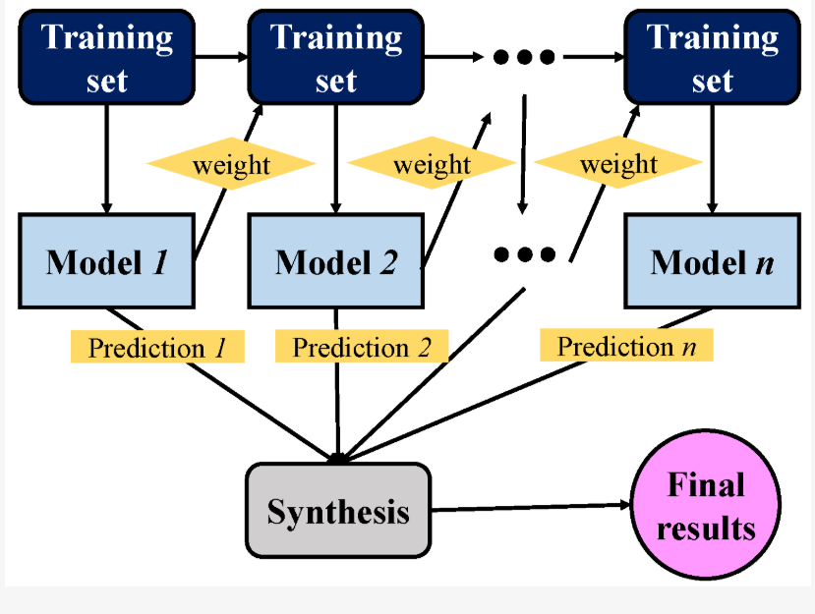
From the image,
The algorithm create multiple models from given dataset sequentially by correcting the mistakes from previous model and combine all the weights and prediction, it gives a final strong prediction.

Slide 4
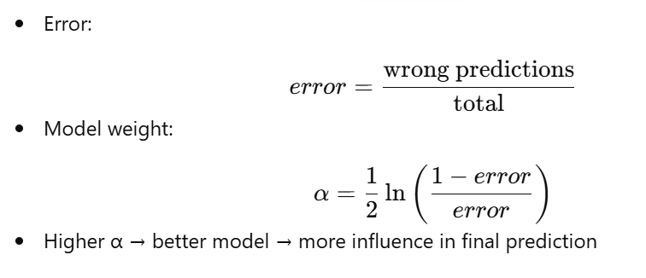
Formula:

Slide 5
Formula (cont…)
The error lies between 0 to 1, If the error is less the model is good.
The α (weight) also lies between 0 to 1, if the weight is high the model is good.

